Slide 1
Vehicle Dynamics and Simulation
Ride Dynamics
Dr B Mason

Slide 2
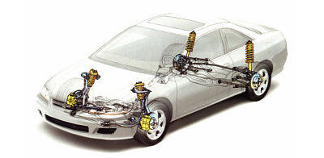
Lecture overview
Excitation input
Quarter car model
Ride response
Active suspension
Human perception

Slide 3
The Ride System
The Ride System
Excitation
Response
Vibration
Perception
Analyses in time or frequency domains

Slide 4
Excitation: Road Roughness
The road surface is the most significant excitation source.

Slide 5
Excitation: Road Roughness
A model for generating excitation input
Generator source: random sequence
Described using;
where;
[1]

Slide 6
Excitation: Road Roughness
Simulated roads can be created using [1] or a random number sequence (coloured noise)
Multiplying cycles/distance (cyc/ft, cyc/m) by vehicle speed gives frequency -> from which PSD can be plotted.
Frequency [cyc/s] = wave number [cyc/m] x speed [m/s]

Slide 7
Excitation: Secondary Effects
Secondary effects include vibration
Driveline
Engine
Wheel/tyre
Typically, at higher frequency than primary excitation sources
Runout occurs due to deformation of the tyre. Imperfections result in different harmonics i.e., mode shapes
‘Runout’ due to tyre deformation

Slide 8
The Quarter Car Model
The simplest ‘useful’ representation of vertical ride dynamics
More simple representations (for quick calcs) is possible considering different modes in isolation.
Body bounce
Wheel hop
Notes:
K_t is much stiffer than k_s so k_s dominates.

Slide 9
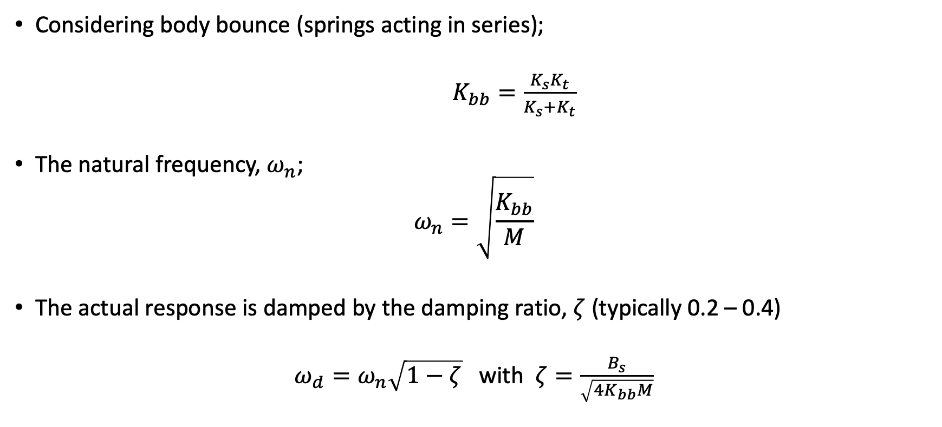
The Quarter Car Model: Body bounce
Considering body bounce (springs acting in series);
$K_{bb}=\frac{K_{s}K_{t}}{K_{s}+K_{t}}$
The natural frequency, $ω_{n}$;
$$ω_{n}=\sqrt{\frac{K_{bb}}{M}}$$
The actual response is damped by the damping ratio, $ζ$ (typically 0.2 – 0.4)
$ω_{d}=ω_{n}\sqrt{1−ζ}$ with $ζ=\frac{B_{s}}{\sqrt{4K_{bb}M}}$

Slide 10

The Quarter Car Model: Wheel hop
For wheel hop;
$$K_{wh}=K_{s}+K_{t}$$
So that the natural frequency, $ω_{n}$
$$ω_{n}=\sqrt{\frac{K_{wh}}{m}}$$

Slide 11
Ride Response
Modelled system
Output: suspension response
Input: from road
Body bounce
Wheel hop
High frequency
attenuation

Slide 12
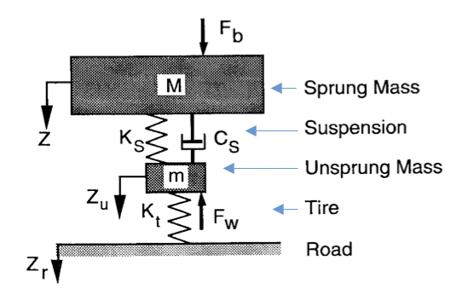
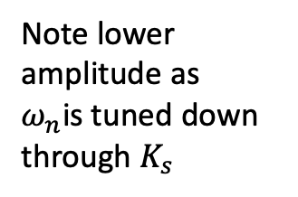

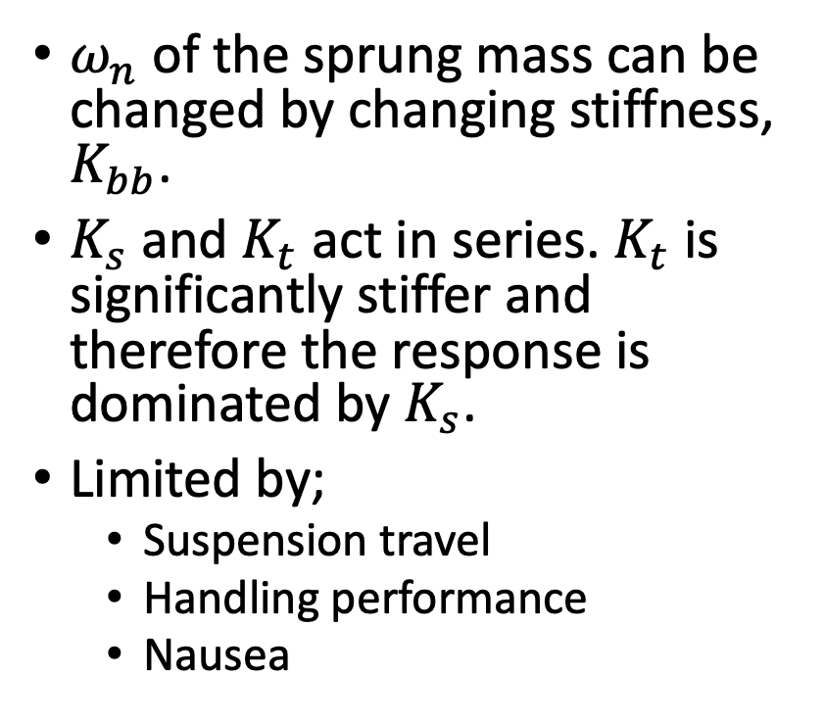
Ride Response
$ω_{n}$ of the sprung mass can be changed by changing stiffness, $K_{bb}$.
$K_{s}$ and $K_{t}$ act in series. $K_{t}$ is significantly stiffer and therefore the response is dominated by $K_{s}$.
Limited by;
Suspension travel
Handling performance
Nausea
Note lower amplitude as
$ω_{n}$is tuned down through $K_{s}$
Changes to $K_{s}$ to change $ω_{n}$ of the sprung mass.

Slide 13
Ride Response
By changing damping also, the peak body response can be reduced.
There are other consequences though for the higher frequencies whose transmission to the body becomes greater.
Effectively ‘tied’ together
body and wheel.
Notes:
Figure 11 shows the effect of increasing Cs to give damping ratio, ζ in the range 0.1 to 2. Note how at the extreme (200% damping) level, the stiff damper has effectively tied the body and wheel together, combining body bounce and wheel hop into one resonance at about 3.5Hz. This would be highly undesirable, due to its affect on the human body. Frequencies of 1Hz and 10Hz feel much better than 4Hz vertically.

Slide 14
Active Suspension
Less easy to manage wheel hop

Slide 15
Bounce and Pitch
Quarter car model – good for body bounce analysis
Half car model required for pitch and bounce analysis
What you feel depends on where you are (centre vs one end or the other)
Principle problem with pitch is the fore-aft motion it causes – nausea!

Slide 16
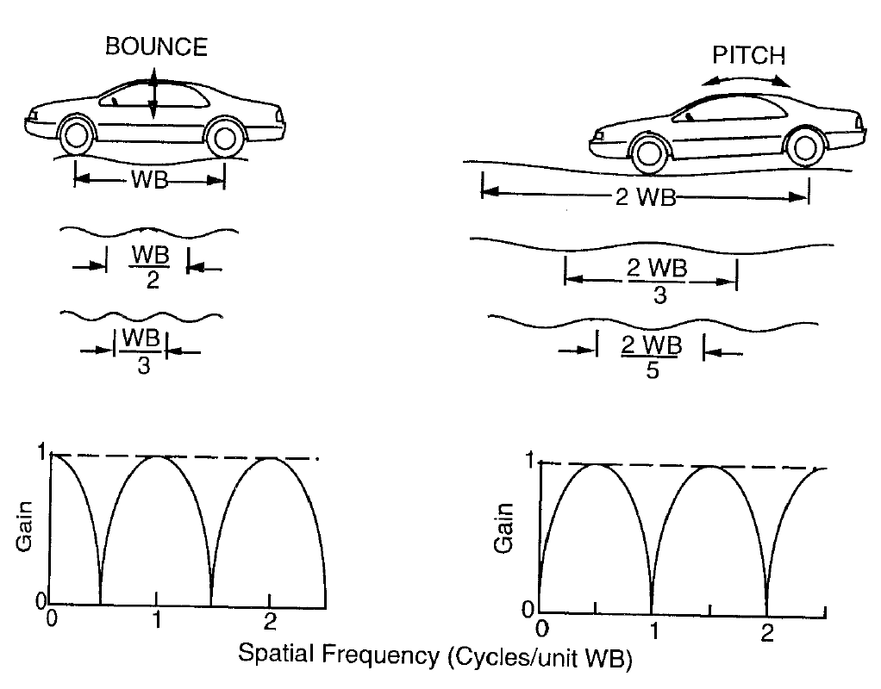
Bounce and Pitch: Wheelbase Filtering
Spacing of the front and rear suspensions can couple with road ‘wavelength’.
Very few roads are sinusoidal!

Slide 17
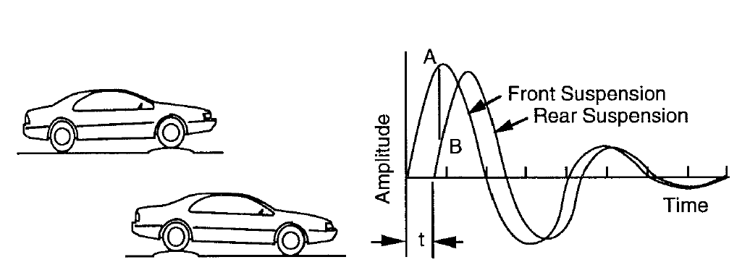
Bounce and Pitch: Ride Rates
By making front ride rate lower it is possible to reduce the discomfort of pitching.
As you hit a bump this induces pitch but resolves to bounce as the rear end ‘catches up’ with the front.

Slide 18
Human Perception
Ride discomfort (lines of equal tolerance) - vertical
We are interested in human perception
Much like the vehicle the human body responds to different ’excitation’ frequencies in different ways.

Slide 19
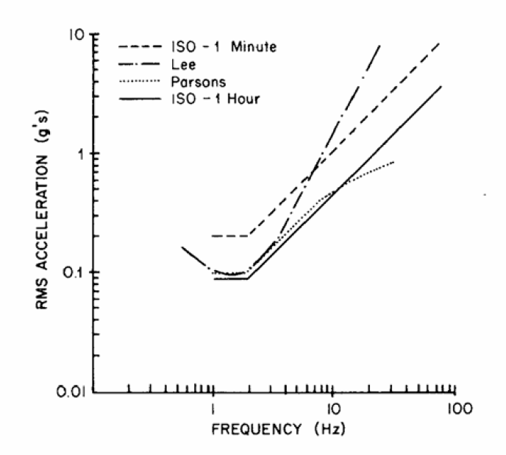
Human Perception
Ride discomfort (lines of equal tolerance) – fore-aft
Fore-aft vibration lines of ‘equal comfort’
Fore-aft tolerance no the same as vertical tolerance.

Slide 20
Conclusions
Excitation input
Quarter car model
Ride response
Active suspension
Human perception

